Slide 1
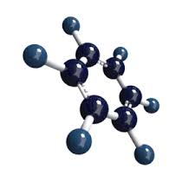
Shri. Shivaji Education Society Amravati’s SHRI.SHIVAJI SCIENCE & ARTS COLLEGE, CHIKHLI.
Affiliated to Sant Gadge Baba Amravati University, Amravati.
B.Sc.Sem - II
CHEMISTRY
Topic-Unit-III Alkyl Halides
AUTHOR
MR. SANDIP V. DAUTPURE
M. Sc. M.Ed. NET , SET
Assistant Professor

Slide 2
CONTENT/SYLLABUS
Vinyl Chloride( Chloroethylene)
Synthesis of Vinyl Chloride from acetylene
Reactions of Vinyl Chloride
Allyl Chloride(3-Chloropropene)
Synthesis of Allyl Chloride from propene.
Reactions of Allyl chloride.
Common Reactions shown by Allyl Chloride.
Comparision of Vinyl and allyl Chloride.

Slide 3
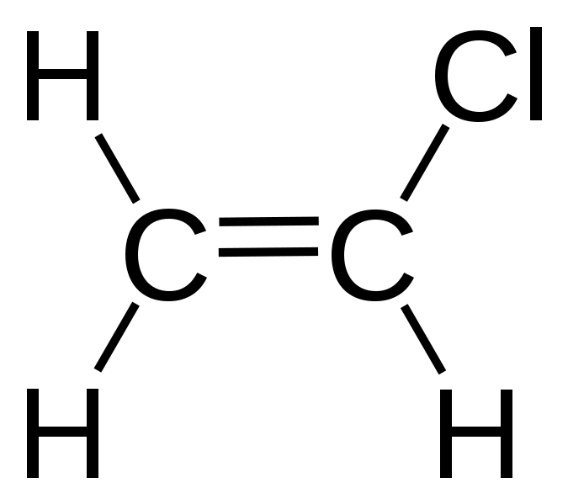
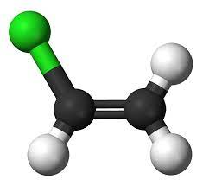
Introduction
Vinyl Chloride is the compound obtained by replacing on of the hydrogen atom in ethylene
In vinyl Chloride , Chlorine atom is bonded to sp2 hybridized carbon atom of the C=C bond.

Slide 4
Synthesis of Vinyl Chloride from Acetylene
Hg2Cl2
433 K

Slide 5
Reactions of Vinyl Chloride
Reactions with Aqueous KOH(Substitution reaction)
CH2=CH-Cl + KOH(aq) → CH2=CH-OH + KCl
Vinyl chloride on heating with aqueous KOH at high temp. under high pressure gives vinyl alcohol.
Reactions with Alcholic KOH(Elimination reaction)
CH2=CH-Cl + KOH(alcoholic) →CH≡ CH + KCl +H2O
CH2=CH-CH-Cl + + KOH(alcoholic) → CH2=C=CH2 +KCl +H2O

Slide 6
Comparison of reactivity of Vinyl and Allyl chloride
Percentage of ‘S’ Character in C-Cl Bond:
Chlorine atom in vinylchloride is attached to sp2 hybridised carbon where as chlorine atom in allyl chloride is attached to sp3 hybridised carbon.
% of s-character in vinyl chloride is 33.30 whereas in allyl chloride it is 25%
More the % of s-character stroger is the bond, hence vinyl chloride is less reactive as compare to allyl chloride

Slide 7
Double Bond Character in C-Cl bond
p-Orbital on chloride in vinyl chloride interacts with adjacent -bond resulting in the formation of delocalization of -bond , Due to this delocalization,c-cl bond acquires partial double bond character.
In case of allyl choride ,p-orbital on chlorine and -bond are separated by sp3 hybridised carbon atom hence delocalization of pi-molecular orbital are not possible hence vinyl chloride is less reactive than allyl chloride.

Slide 8
Extra Stability of Allyl carbocation
Resonating Structure of Allyl Carbocation
Note: No resonating structure are possible for vinyl carbocation.
More reactivity of allyl carbocation than a vinyl chloride is also supported by the fact that vinyl carbocation are relatively unstable and allyl carbocations are stabilized by resonance as shown above hence allyl chloride are more reactive than vinyl chloride.

Slide 9
In case of chloroethylene , halogen is attatached to which type of carbon
Sp
Sp2
Sp3
sp2d

Slide 10
Thanks !!!

